Slide 1
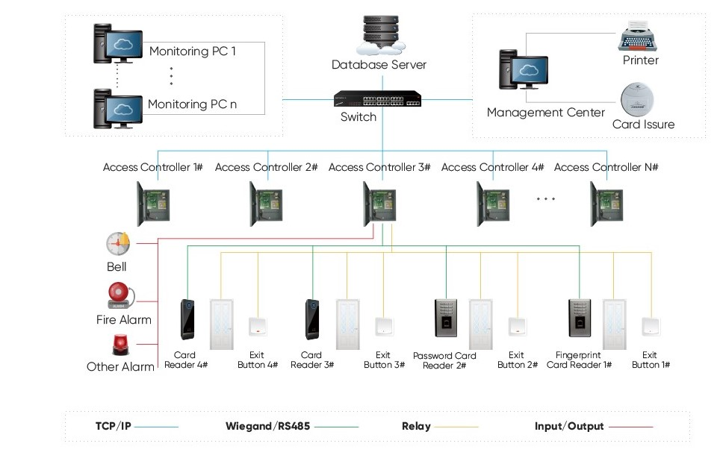
Introduction and proposal description

Slide 2
Technology used
HTML
CSS

Slide 4

Prototype

Slide 5
Any questions?
Thank you

